Slide 1


Database Query in Natural Language : Customer Complaints
Capstone Project

Slide 2

About us - GROUP 3
Sumit Kumar(2021AIML561)
Ramya Kanthamaneni(2021AIML549)
Phani Kumar(2021AIML574)
Maruti Ram(2021AIML588)
Ganga Bhavani Periketi(2021AIML556)

Slide 3

About Us
NLIDB – Database Query in Natural Language
Provides information stored in the database by typing requests in natural language, without the knowledge of database languages
Amerish Kesar(2021AIML539)
Balakrishna Tammisetty(2021AIML586)
Puneet Khurana(2021AIML547)
Shubham Mohan Sharma(2021AIML610)

Slide 4

Introduction
In today's digital age, access to accurate and relevant information is crucial for the success of businesses and organizations.
The vast amounts of data generated by platforms and traffic sources can make it challenging for platform owners and traffic analysts to retrieve the information they need.
This is where Natural Language Interface Database (NLIDB) comes into play.
The goal of this project is to develop a solution that democratizes information retrieval for platform owners and traffic analysts, making it easier for them to access and analyse the data they need.

Slide 5

Problem Statement
The current methods of accessing and analysing data from platforms and traffic sources are time-consuming, complex, and often inaccurate.
This makes it difficult for platform owners and traffic analysts to make informed decisions based on the data they have access to.

Slide 6

Objectives
The main objectives of this project are:
To develop a natural language interface for retrieving information from databases.
To improve the accuracy and efficiency of information retrieval using advanced NLP techniques and machine learning algorithms.
To empower platform owners and traffic analysts with an intuitive and user-friendly interface for accessing and analysing data.

Slide 7

Approach
The project will use a combination of NLP techniques and machine learning algorithms to develop a natural language interface for retrieving information from databases. The approach will involve:
Data collection and pre-processing: Collecting data from various platforms and traffic sources, and pre-processing the data to make it suitable for analysis.
NLP techniques: Implementing NLP techniques, such as sentiment analysis, topic modelling, and named entity recognition, to extract relevant information from the data.
Machine learning algorithms: Using machine learning algorithms, such as decision trees, random forests, and gradient boosting, to classify and predict patterns in the data.
User interface design: Designing a user-friendly interface that enables platform owners and traffic analysts to retrieve and analyse information in a simple and intuitive way.

Slide 8

Deliverables
The key deliverables of this project include:
A natural language interface for retrieving information from databases.
Improved accuracy and efficiency of information retrieval.
A user-friendly interface for accessing and analysing data.
Documentation of the project, including a user manual and technical documentation.

Slide 9

Risks & Challenges
Potential risks and challenges that may impact the success of the project include:
Data quality and availability: The quality and availability of data from platforms and traffic sources may impact the accuracy of the information retrieval system.
Technical difficulties: The implementation of NLP techniques and machine learning algorithms may be technically challenging and require specialized expertise.
User adoption: The success of the project will depend on the willingness of platform owners and traffic analysts to adopt the natural language interface.

Slide 10

Conclusion
This project has the potential to revolutionize the way platform owners and traffic analysts access and analyse data.
By democratizing information retrieval, this project will empower businesses and organizations with the information they need to make informed decisions and achieve their goals.

Slide 11
DATASET
We have taken the dataset of customer complaints to be used for our project. We will be using NLIDB to retrieve the data from the customer complaints dataset.
This data is a collection of complaints about consumer financial products and services that we sent to companies for response.
Complaints are published after the company responds, confirming a commercial relationship with the consumer, or after 15 days, whichever comes first
The dataset comprises of Consumer Complaints on Financial products and we’ll see how to classify consumer complaints text into these categories: Debt collection, Consumer Loan, Mortgage, Credit card, Credit reporting, Student loan, Bank account or service, Payday loan, Money transfers, Other financial service, Prepaid card. Also we will try to identify the companies from the dataset

Slide 12

About Us
Customer Complaints : EDA
Exploratory Data Analysis on the data provided

Slide 13
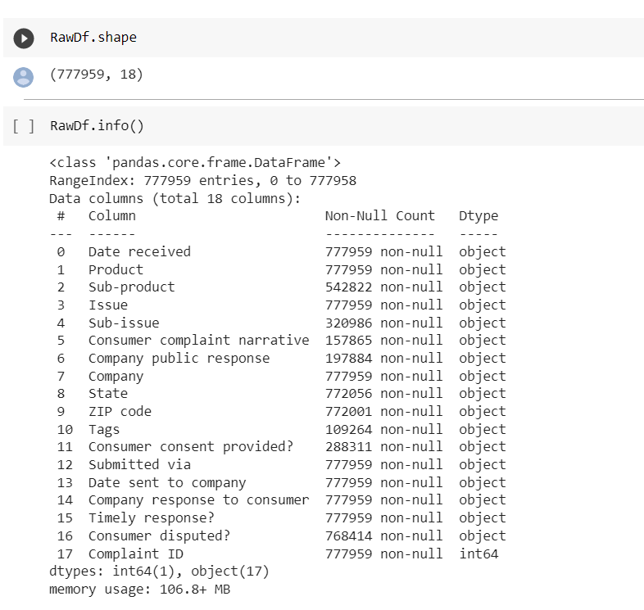
EDA - DATA
There 1 Integer value out of 17 attributes
There are 17 Object values out od 17 attributes
Data set is having 18 columns and 777958 rows

Slide 14
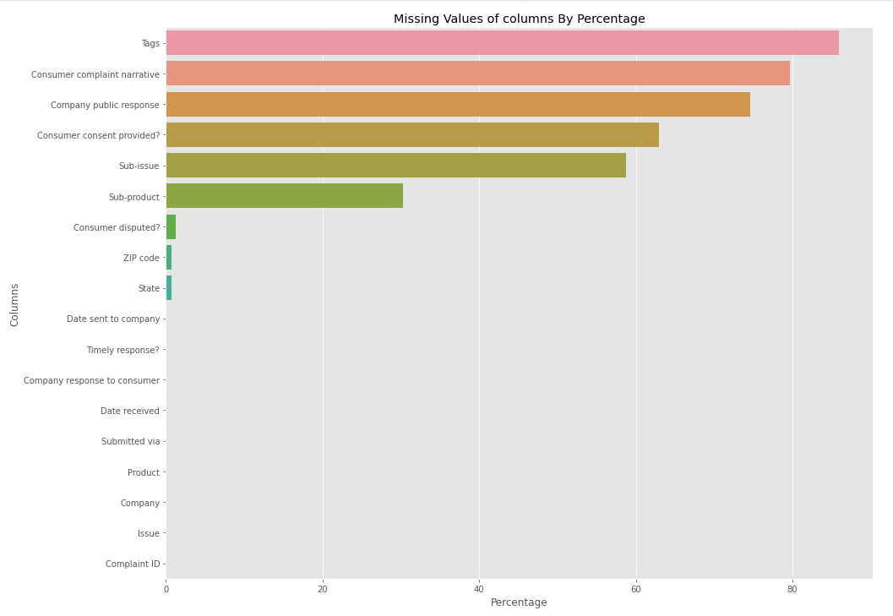
EDA – Missing Data
We can see there are some columns which have lots of missing value it will effect our model so we drop that column which have more than 10% of missing value

Slide 15
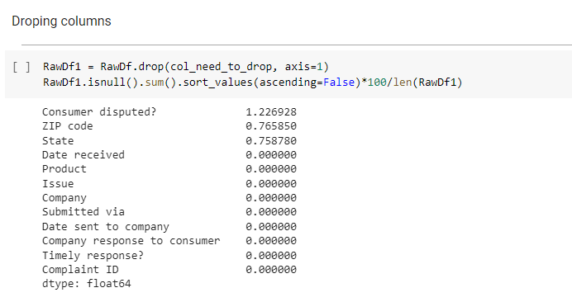
EDA – DROPPING COLUMNS
We can see columns are dropped and there only 3 columns which have less than 2 percent of missing value we can drop the raws of missing value that will not effect our data quality

Slide 16
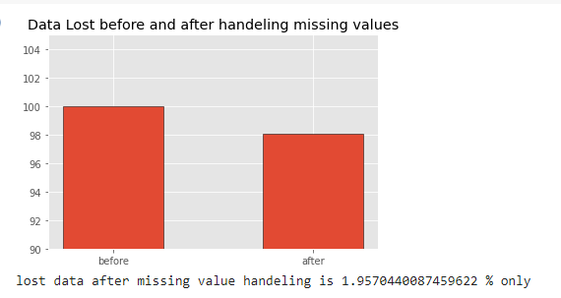
EDA – LOST DATA
Lost data after missing value handling is
1.9570440087459622 % only

Slide 17

About Us
Customer Complaints : Data Analysis & Visualization

Slide 18
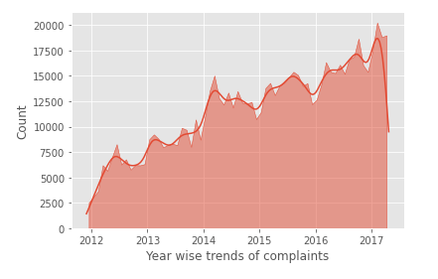
DATA ANALYSIS & VISUALIZATION
Complaints Data
Year by Year complaints was
increased

Slide 19
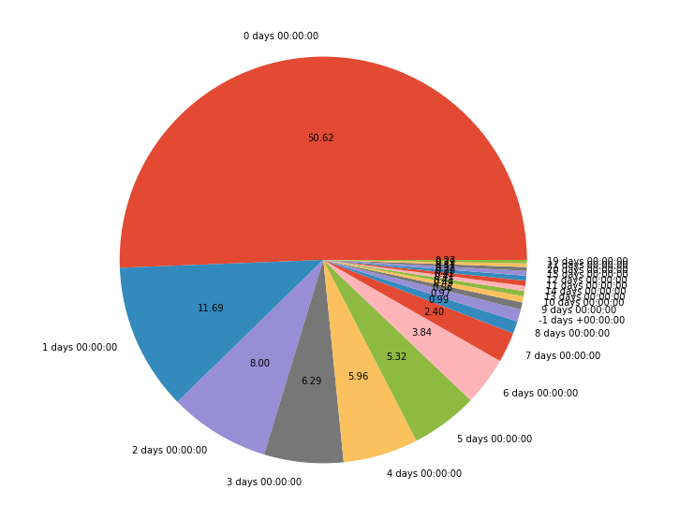
DATA ANALYSIS & VISUALIZATION
Complaints Response Data
50% of Complaint has been sent to company On the same day 11th percent of complaint has been sent to company after one days 8% of
complaint sends to company
after 2 days

Slide 20
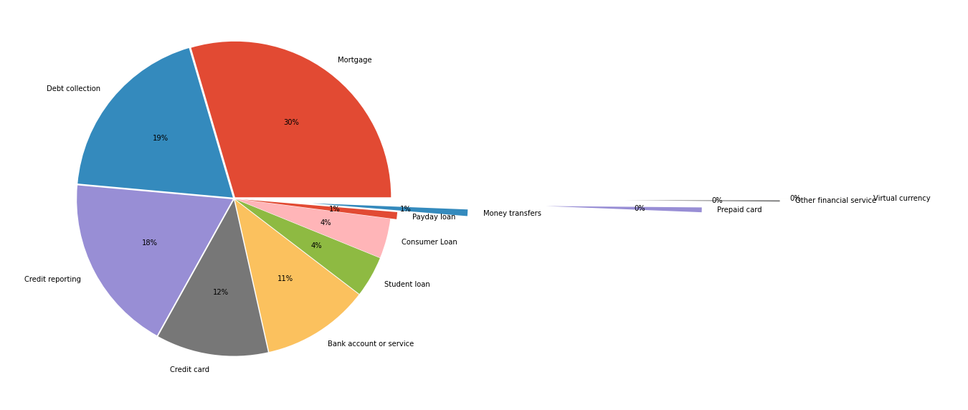
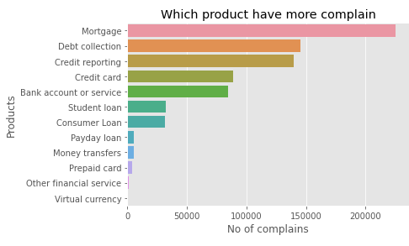
DATA ANALYSIS & VISUALIZATION
Complaints by Products Data
mortgage offer 30% of complaints tab collections cover 19% of complaint credit reporting covers 18% of complaint anti credit card covers only 12 persons of complaint and also we can conclude that consumer loan content 4 persons of complaint HO final conclusion will be consumer loan and pay day loan , prepaid card have low customer complaint

Slide 21
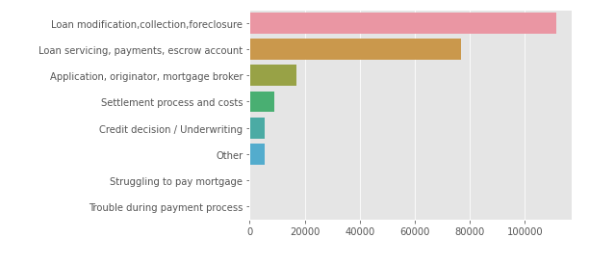
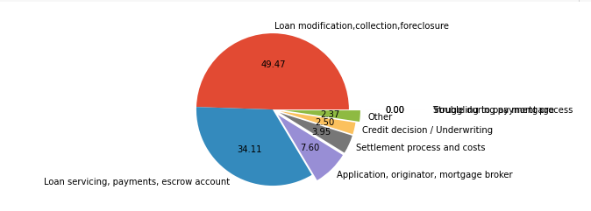
DATA ANALYSIS & VISUALIZATION
Complaints by Mortgage Data
By checking the pie chart we can conclude that product mortgage have most of the complaints for loan modifications collections for closure and loan servicing payments escrow account. It should be look after what is the problem with that upper mension category

Slide 22
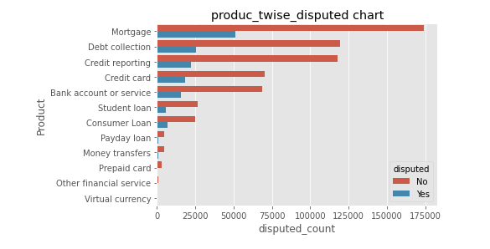
DATA ANALYSIS & VISUALIZATION
Product wise Disputes Data
Only less than 25 percent of complain in every product is disputed Cause may be customer giving falls complains or company dont
want to give claims

Slide 23
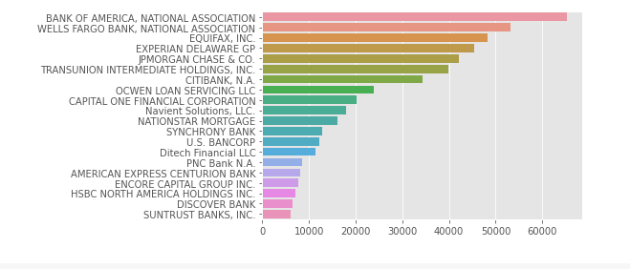
DATA ANALYSIS & VISUALIZATION
Company Analysis Data
Top 20 company which received highest complaints

Slide 24
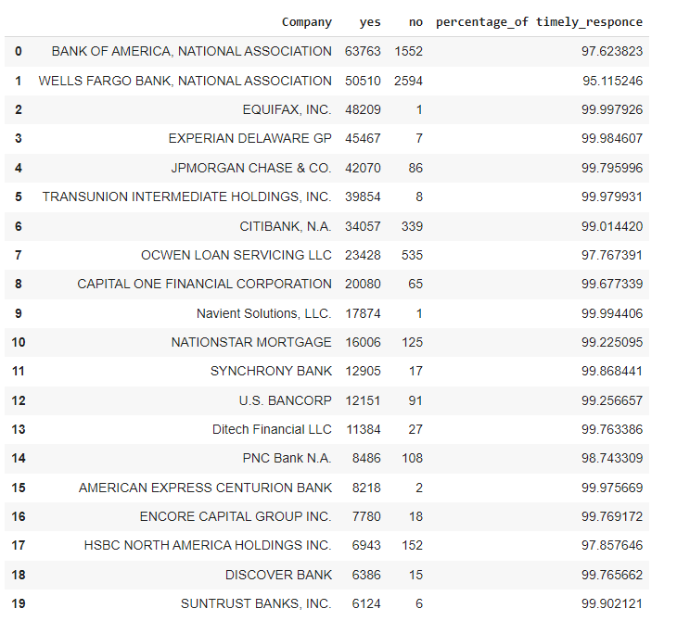
DATA ANALYSIS & VISUALIZATION
Company vs Timely Response Percentage

Slide 25
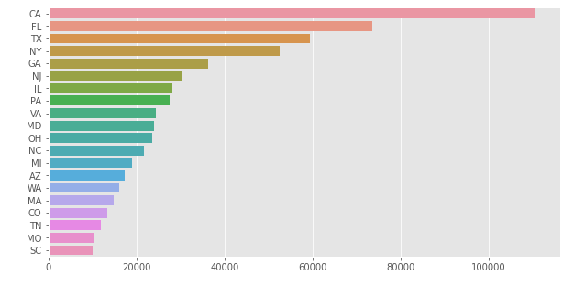
DATA ANALYSIS & VISUALIZATION
Statewise Complaint Analysis Data
That means more tahn 82% of
the product sells in those
states
'CA', 'FL', 'TX', 'NY', 'GA', 'NJ', 'IL', 'PA', 'VA', 'MD', 'OH', 'NC', 'MI', 'AZ', 'WA', 'MA', 'CO', 'TN', 'MO’,
'SC'

Slide 26
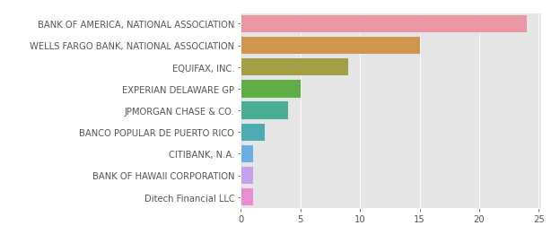
DATA ANALYSIS & VISUALIZATION
Companywise with States Complaint Analysis Data
Bank of America has topped the list of complaints in 24 states and
Wells Fargo has topped in 15 states

Slide 27
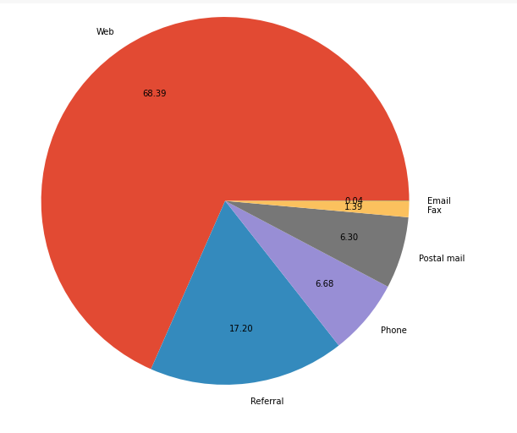
DATA ANALYSIS & VISUALIZATION
Mode of Submitted Complaints Data
Complaints submitted through web 68.39%
Complaints submitted through
referral 17.20%
Complaints submitted through phone 6.68%
Complaints submitted email is very less

Slide 28
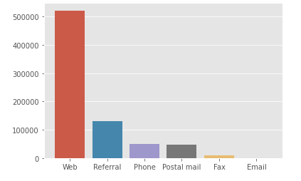
DATA ANALYSIS & VISUALIZATION
Complaints vs Submitted Mode Data
Most practices way for
complaint is via WEB
Email is not the accepted way for compliants

Slide 29
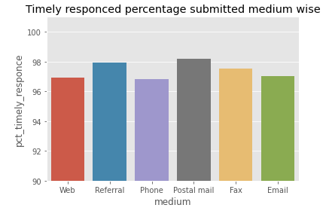
DATA ANALYSIS & VISUALIZATION
Timely Response vs Submitted Mode Data
Complaints submitted by
postal mail is with the highest
timely response but other
mode however received more than 96% timely response

Slide 30
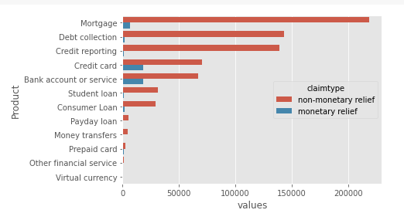
DATA ANALYSIS & VISUALIZATION
Product vs Claim Type Data
We can conclude from the
graph that credit card and bank account service have high no of monetary benefit
compared to others

Slide 31
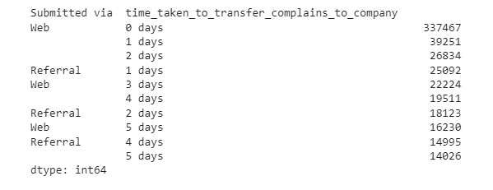
DATA ANALYSIS & VISUALIZATION
Mode vs Complaints Time to company Data

Slide 32


About Us
Customer Complaints : Data Analysis & Visualization

Slide 33
MODEL TRAINING
We have used TAPEX model to solve the problem
TAPEX (Table Pre-training via Execution) is a model for simulating neural SQL execution, i.e., employ TAPEX to execute a SQL query on a given table.
TAPEX can be fine-tuned to tackle table question answering tasks and table fact verification tasks.
We are using this model on our structured dataset

Slide 34

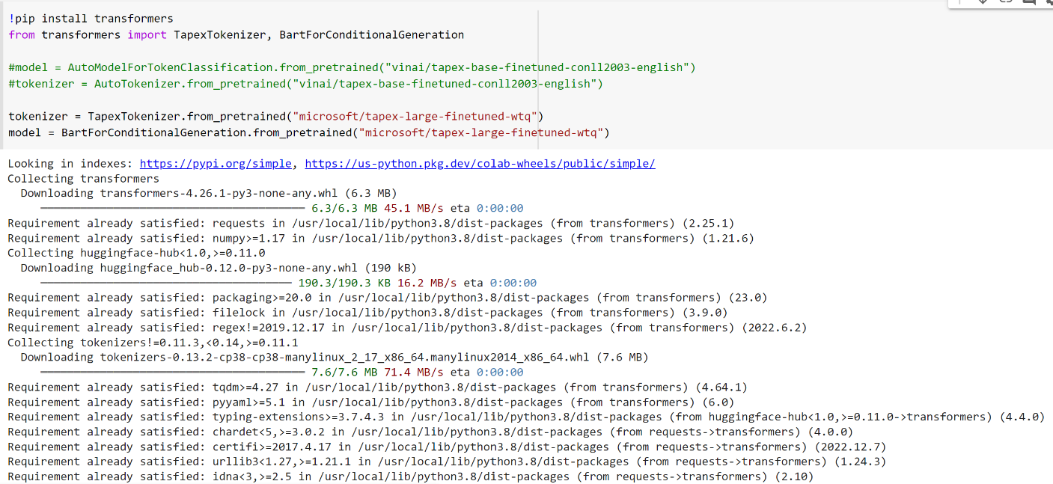
MODEL TRAINING – Importing TAPEX

Slide 35
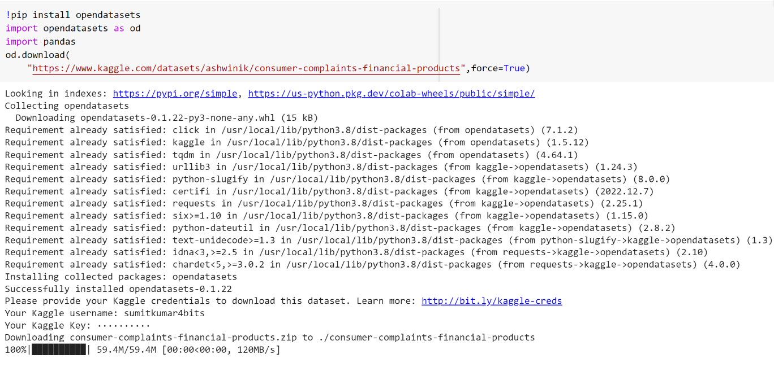
MODEL TRAINING – Loading Dataset

Slide 36

DATA SET UPDATION
Since TAPEX model is pre-trained but will not able to provide the results of the queries for larger data
To retrieve the data using TAPEX model, we have updated the dataset to 1023 rows with 18 columns
Furthermore, we will be working in retrieving the data by increasing the dataset size.

Slide 37
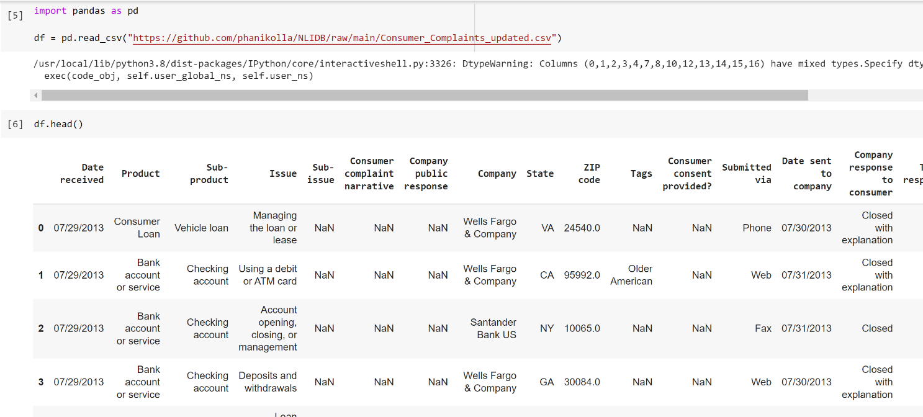
DATA SET UPDATION(Contd.)

Slide 38

About Us

Slide 39
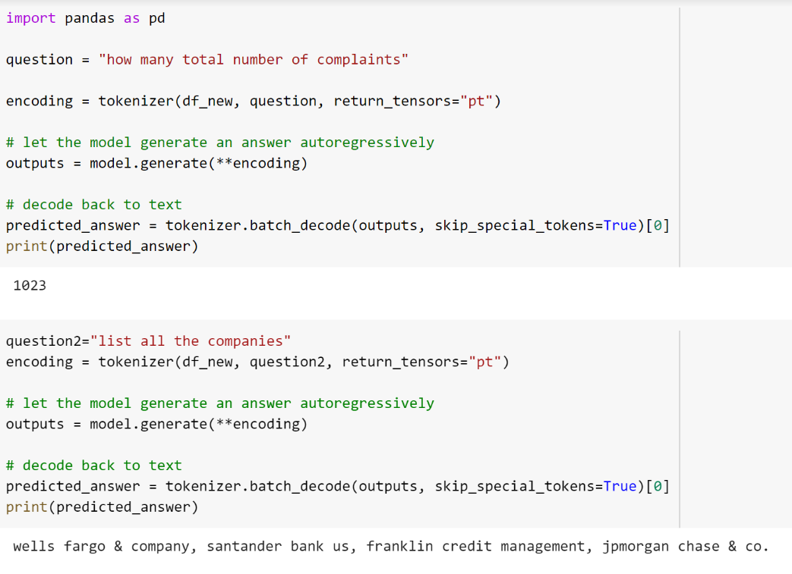
MODEL Training Results - NLIDB
Since the dataset is of lesser size now, we were able to fetch the data from the dataset using natural language

Slide 40

About Us

